Slide 1
Governance
Microsoft Cloud Adoption Framework

Slide 2
Microsoft Cloud Adoption Framework for Azure
Adopt
Define Strategy
Understand motivations
Business outcomes
Business justification
Prioritize project
Plan
Digital estate
Initial organization alignment
Skills readiness plan
Cloud adoption plan
Ready
Azure readiness guide
First landing zone
Expand the blueprint
Best practice Validation
Migrate
• First workload migration
• Expanded scenarios
• Best practice validation
• Process improvements
Innovate
• Innovation guide
• Expanded scenarios
• Best practice validation
• Process improvements
Govern
Methodology • Benchmark
initial best practice • Governance maturity
Manage
Business commitments
operations baseline • Ops maturity

Slide 3

The major drivers for IT governance
Keep risk at acceptable levels
Maintain availability to systems and services
Consistently apply policy and audit compliance
Protect customer data
Notes:
Governance is about reducing risk, adhering to regulatory requirements and managing costs while allowing the business to operate effectively and without impedance.
Governance is about meeting strategic objectives (performance) while meeting legal and regulatory, contractual and other obligatory requirements often supported by policies (conformance). The goal is to achieve both in a balanced way.

Slide 4
Objective of this model: Create balance
Speed &
Results
Control & Stability
Notes:
Often the value of cloud services (speed, agility, innovation, cost, security) is often negatively impacted by existing/legacy enterprise IT processes and practices (Legacy doesn’t work)

Slide 5

How do we get started?
Framework
Frame the conversation to mitigate tangible business risks through consistent governance
1
Assess
Assess current state and future state to establish a vision for applying the framework
2
MVP
Establish a Minimally Viable Product (MVP) to serve as a foundation for governance
3
Evolve
Mature with each release to align Cloud Adoption and existing IT functions
4

Slide 6
How do we get started?
Framework
Frame the conversation to mitigate tangible business risks through consistent governance
1
Assess
Assess current state and future state to establish a vision for applying the framework
2
MVP
Establish a Minimally Viable Product (MVP) to serve as a foundation for governance
3
Evolve
Mature with each release to align Cloud Adoption and existing IT functions
4

Slide 7
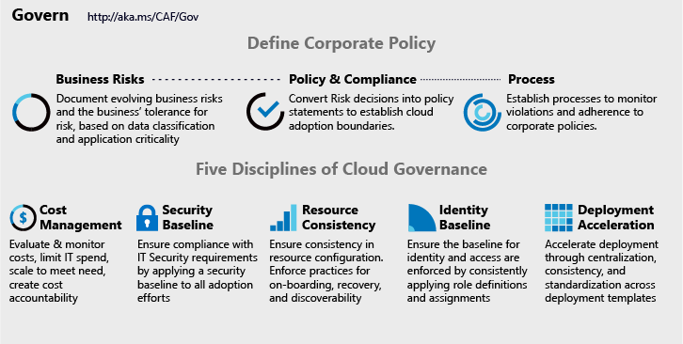
CAF Governance Model
Governance End State that fosters trust and builds confidence
Corporate Policy
Governance is a big, intimidating topic. Establish proper scope by mitigating tangible risks through corporate policy.
Cloud Governance Disciplines
Governance is a team sport. Empower multiple team members by decomposing corporate policy changes into five actionable disciplines.
Cloud Governance Team
A team of governance minded cloud architects can evolve these disciplines, ensure governance consistency, and accelerate deployment.
Notes:
Talk track:
The CAF model to governance is a way of approaching governance that allows us to decompose complex and emotional topics into smaller units of actionable change.
In the sections on Defining Corporate Policy, we change the topic from alignment to current IT governance requirements to a realistic look at tangible risks created by cloud adoption. Those risks can generate policy & compliance statements and recurring processes, which augment existing IT Governance Policy.
Actioning on those policy statements, is done in one of five buckets of activity that span the governance conversations. In each of the five disciplines, the Cloud Governance Team leverages the Configuration Management capabilities of the Azure Govern and Azure Manage tools to help IT Governance, IT Security, Identity, and Networking teams apply requirements consistently across all Azure adoption.
In this session, we will focus on the tools that establish a foundation for governance in Azure, which can be used to accelerate all five disciplines. These tools will aid in ensuring that the requirements of each discipline is consistently applied, audited, & enforced.

Slide 8
Governance disciplines

Slide 9
How do we get started?
Framework
Frame the conversation to mitigate tangible business risks through consistent governance
1
Assess
Assess current state and future state to establish a vision for applying the framework
2
MVP
Establish a Minimally Viable Product (MVP) to serve as a foundation for governance
3
Evolve
Mature with each release to align Cloud Adoption and existing IT functions
4

Slide 10
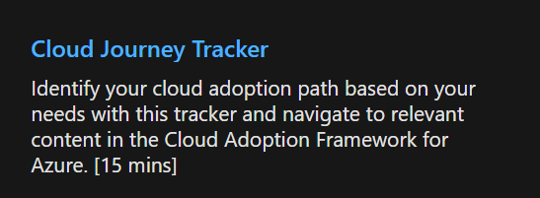
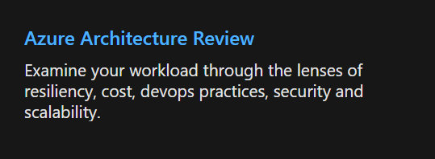
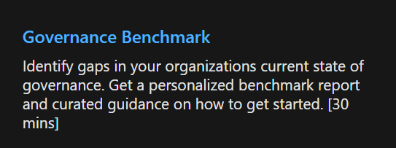
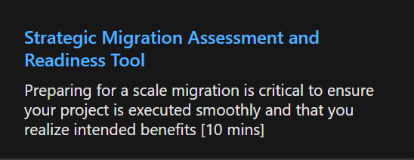
Cloud Adoption Assessments
Organisations can evaluate their business strategies and receive curated guidance from Microsoft Assessments

Slide 11
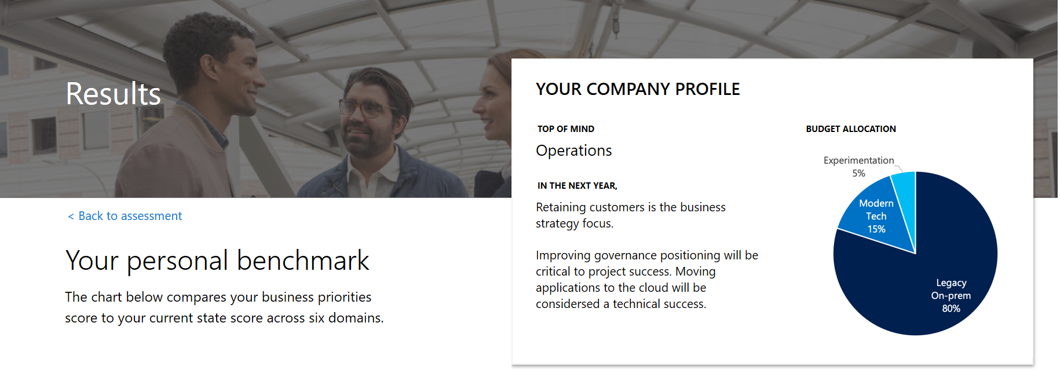
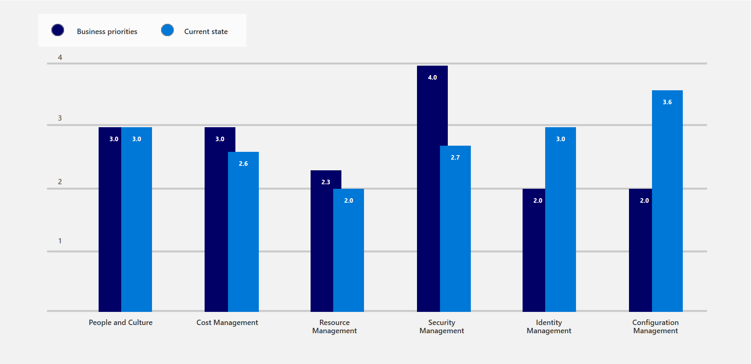
Evaluating current state
Security management appears to be an important area to focus for this customer

Slide 12

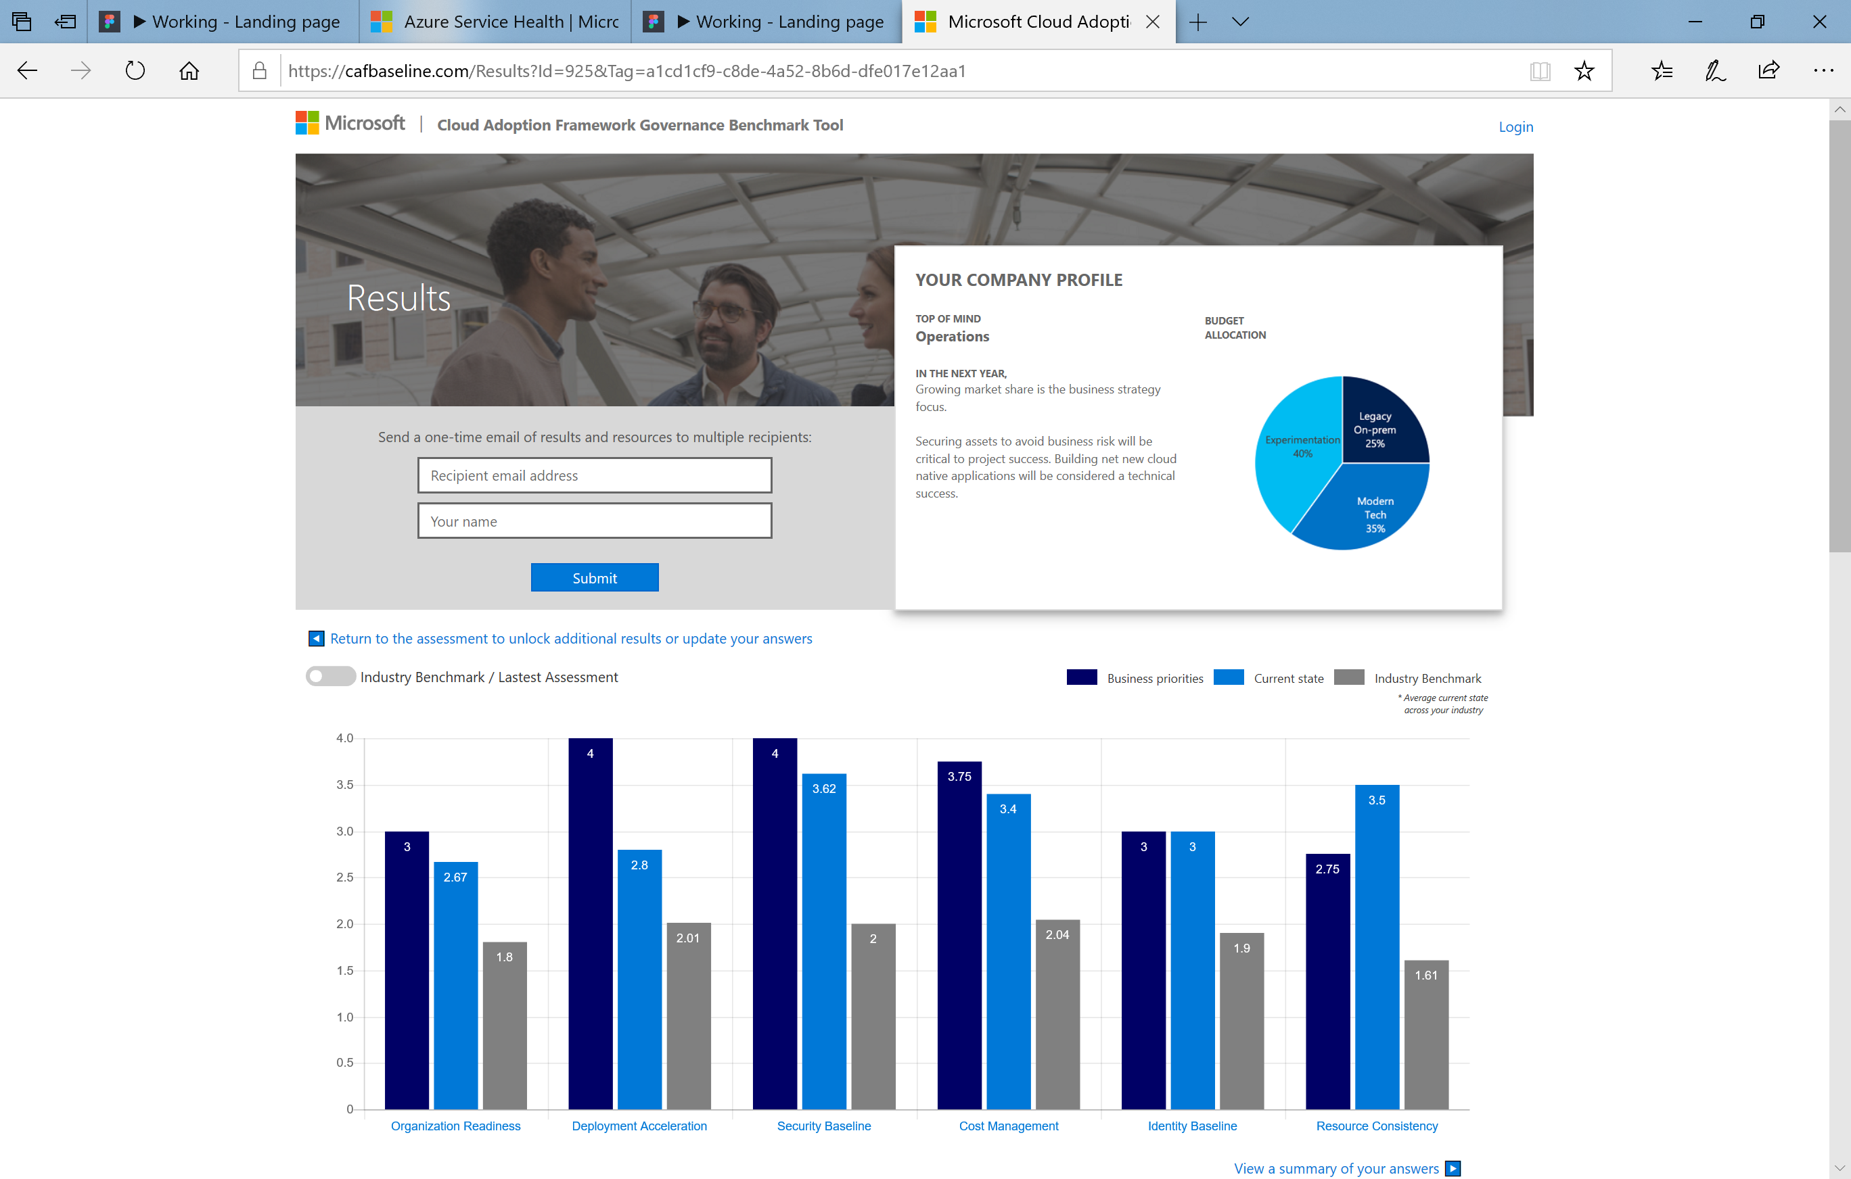
Understand your current state and prepare for your cloud journey using
the Governance benchmark tool
https://cafbaseline.com/

Slide 13
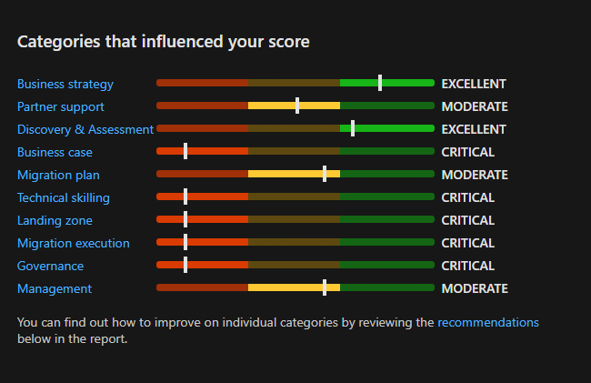
Migration readiness assessment
Assess the organization’s readiness to migrate to cloud.

Slide 14
How do we get started?
Framework
Frame the conversation to mitigate tangible business risks through consistent governance
1
Assess
Assess current state and future state to establish a vision for applying the framework
2
MVP
Establish a Minimally Viable Product (MVP) to serve as a foundation for governance
3
Evolve
Mature with each release to align Cloud Adoption and existing IT functions
4

Slide 15
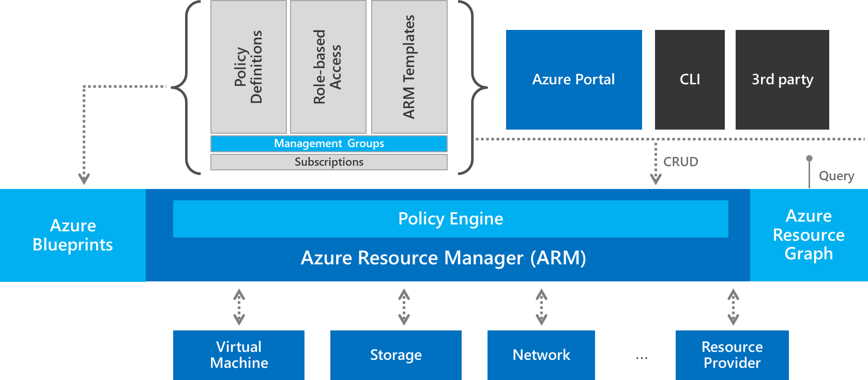
Critical Partners
Building the right MVP
Governance is a team sport
Defining a governance MVP creates an opportunity to partner with existing IT functions, in manageable implementations.
Cloud Adoption: understand the plan for adoption, deployment, or migration to the cloud
IT Security: Understand initial identity, encryption, and networking requirements
Identity: Align to hybrid identity implementation
Network: Align to existing network criteria
Storage: Align to encryption practices
Remember Tangible Risks
An MVP doesn’t attempt to fulfill all requirements. Instead, collaborate with each team to identify the minimum requirements based on the current cloud adoption plan.

Slide 16
Azure Governance Architecture
Starting point for Governance MVP
Policy Definitions
Role-based Access
Resource Manager Templates
Management Groups
Subscriptions
Azure Portal
SDK
3rd party
Environment Factory: Deploy and update cloud environments in a repeatable manner using composable artifacts
Resource Groups
CRUD
Query
Azure Blueprints
Policy Engine
Azure Resource Graph
Azure Resource Manager
2. Policy-based Control: Real-time enforcement, compliance assessment and remediation at scale
3. Resource Visibility: Query, explore & analyze cloud resources at scale
Virtual Machine
Storage
Network
…
Resource Provider

Slide 17
Making Governance actionable with native tools
Azure Blueprints
Azure Policy
Azure Cost Management
Azure Advisor
Azure Portal
Azure EA Content Pack
Azure Blueprint
Azure Policy
Resource Grouping & Tagging
Resource Manager Templates
Azure DevOps
Azure Site Recovery
Azure Backup
Azure Automation
Azure Blueprints
Azure Policy
Azure Security Center
Subscription Design
Encryption
Hybrid Identity
Azure Networking
Azure Automation
Azure Blueprints
Azure Policy
Azure Monitor
Resource Manager Templates
Resource Graph
Management Groups
Azure Blueprints
RBAC
Azure AD
Azure AD B2B
Azure AD B2C
Directory Federation
Directory Replication
Notes:
Talking points: The five disciplines of cloud governance is a grouping of challenges faced by cloud customers (Both Azure customers and the users of other clouds). This grouping was devised and validated through direct conversations and independent studies across hundreds of hours of interviews. The five disciplines are universal to cloud users as cloud agnostic guiding principles. They are ranked in order of concern, based on user feedback.
Unfortunately, implementation of those disciplines is very cloud specific. Lets step through approaches to action on the five disciplines in Azure.
Animation 1: Configuration Management – Is the first of 2 bookends that represent the domain of the Cloud Governance Team. Cloud Governance shares many commonalities with DevOps and is rooting firmly in configuration management. Establishing a Governance MVP rooting in proper nomenclature, subscription strategies, resource grouping, and resource tagging strategies is vital. Those initial strategies (AND ALL OTHER GOVERNANCE IMPLEMENTATION) is then executed through governance tools consisting of Azure Blueprints, Azure Policy, Azure Resource Manager Templates, Azure Management Groups, and Azure Resource Groups. Master these tools and concepts and incremental governance will flow smoothly.
Additional partners in this discipline should include Disaster Recovery, Business Continuity, and/or DevOps specialists, when available.
Animation 2: Identity is still the domain of identity experts. As identity policies and requirements are defined, governance tooling and processes from the Configuration Management discipline can govern application of those requirements across all deployments.
Animation 3: Resource management is the domain of IT ops or Cloud operations. However, the governance team aids in identifying what needs monitoring & to what level of criticality. Governance tooling and processes from the Configuration Management discipline enforces the discoverability of assets and other operations requirements, across all deployments.
Animation 4: Security Management is the domain of IT Security or Cyber Security specialists. They should define all security requirements. However, the governance team aids in identifying data classifications and protection levels. Governance tooling and processes from the Configuration Management discipline enforces the application of security requirements, across all deployments.
Animation 5: Cost Management is the second book end for the domain of the Cloud Governance Team. It is also one of the most common concerns among customers. Just as configuration management is important to rapid governance implementation. Azure Cost Management or Cloudyn is important for control of costs in the cloud. Providing a holistic view of spend and a centralized means of controlling spend is a very important aspect of Cloud Governance. In fact, it is commonly the first and clearest justification for investments in Cloud Governance.
Cloud governance depends on a partnership with many teams. Likewise, those teams will come to depend on Cloud Governance for comprehensive and swift application of policy across cloud solutions. This model helps better align corporate policy to governance actions and the impacted teams.

Slide 18
Integrating 3rd Party Tools
Cost Management 3rd party
Resourcing, Tagging, Grouping, and Deployment template management 3rd parties
Could cross over into Devops tooling
Security baselining 3rd party
Discovery, onboarding, and recovery 3rd parties
3rd party identity providers
Notes:
What third parties can be used to accomplish similar goals?

Slide 19
Demo: Tagging Policy & Remediation

Slide 20
Demo: Audit PCI-DSS compliance

Slide 21
Demo: PCI-DSS Azure Blueprints

Slide 22
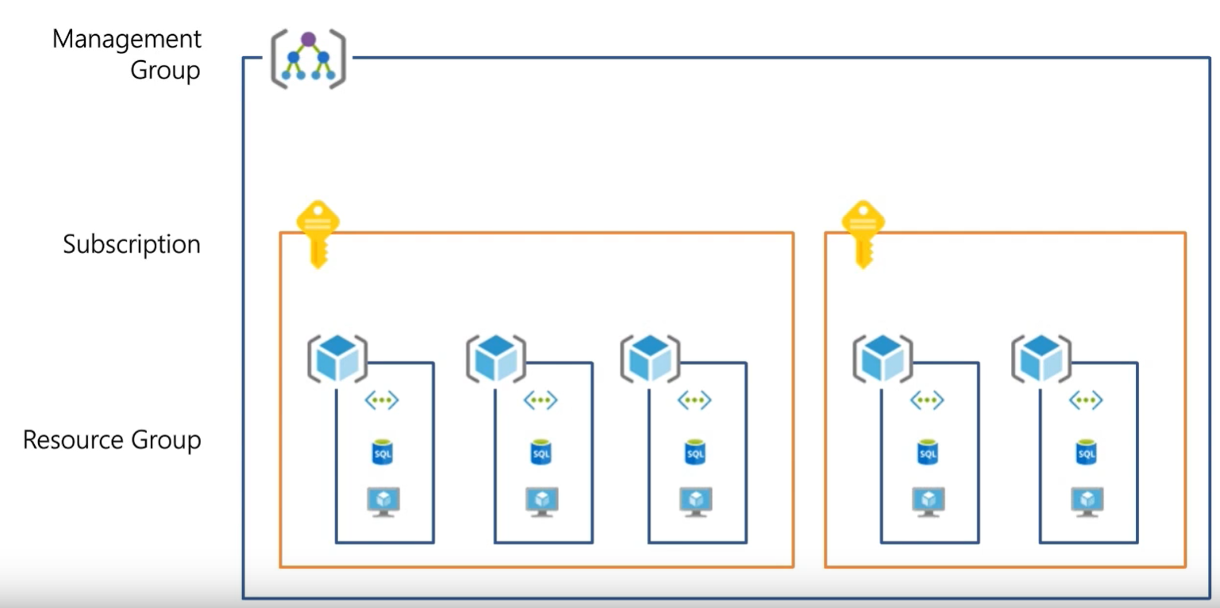
Resource Organization
The basic foundation of all governance practices
Sound Governance starts with resource organization strategies.
Management Groups: To reflect security, operations and business/accounting hierarchies
2. Subscriptions: To group similar resources into logical collections
3. Resource Groups: To further group applications or workloads into deployment and operations units

Slide 23
Azure Policy repository
https://github.com/Azure/azure-policy/
Notes:
Tailwind Traders wants to manage resource tags and cost with Azure policy.
Assign pre-created policy from the Azure portal
Create and assign a custom policy with automation tools
Create and assign a policy initiative

Slide 24
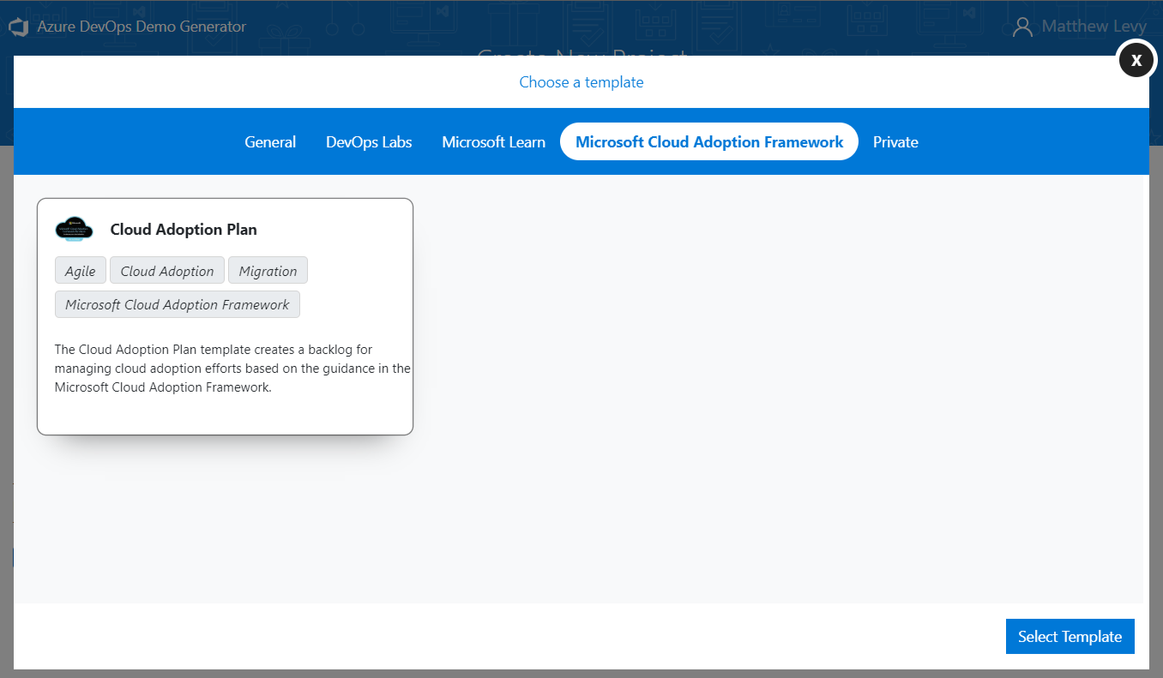
Azure DevOps Template
https://aka.ms/adopt/plan/generator

Slide 25
How do we get started?
Framework
Frame the conversation to mitigate tangible business risks through consistent governance
1
Assess
Assess current state and future state to establish a vision for applying the framework
2
MVP
Establish a Minimally Viable Product (MVP) to serve as a foundation for governance
3
Evolve
Mature with each release to align Cloud Adoption and existing IT functions
4

Slide 26
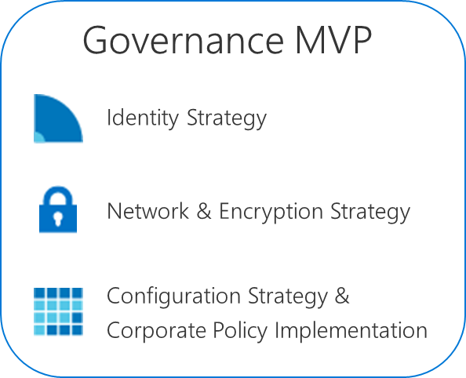
Risk-Driven Evolution Keep the big picture in mind, but align tasks based on immediate tangible risks
Release
Release
Release
Release
Release
Milestone
Cloud Adoption Timeline
Predict, don’t guess
We could make educated guesses about future, milestone risks. We can accurately predict those risks per release.
Governance Evolution
The Cloud Governance Team then
asks deeper questions to establish a
governance release plan.
Will application criticality in this release impact policies regarding IT Operations or Cloud Operations?
Will data classifications in this release impact policies regarding IT Security?
Release Plan
Will the suggested deployment impact pricing, planned spend, or cloud budget?
Will the application requirements impact identity policies or implementation?
Will any of these answers impact configuration management implementations or require the implementation of new corporate policies?
Notes:
With an incremental approach to cloud governance, there is sometimes a natural friction between teams building new business solutions and teams protecting the business from risks. However, in this model those two teams can become peers working in increments or sprints.
As peers, the cloud governance team and the cloud adoption teams begin to work together to expose, evaluate, and remediate business risks. This effort can create a natural means of reducing friction and building collaboration between teams.

